Slide 1

CMPP 257
Introduction to JavaScript
& jQuery
Module 6: Introduction to jQuery
Dr. Hamdy Ibrahim

Slide 2
Outlines
jQuery Overview
Including jQuery in Webpage
Basic jQuery Syntax
Document Ready Event
Basic Selectors and Methods
Getters and Setters Terms
CMPP 257: Introduction to JavaScript & jQuery
2

Slide 3
What is jQuery?
Free and Open Source JS Library
JQuery
It is a JS script (Written in JS)
Making Website more Interactive and Dynamic
Select/Find HTML Elements
Manipulate the Selected HTML Elements
JQuery
Traversing DOM & Manipulating its Elements
Event Handling & CSS Manipulation
Much More
3

Slide 4
Why jQuery?
Write Less and Do More → Rapid Development
Well Documented & Supported
Popular & Easy to Learn
Compatible with All Browsers
Hide divs with pure JavaScript
divs = document.getElementByTagName(‘div’); for (i = 0; i < divs.length; i++) { divs[i].style.display = ‘none’; }
Hide divs with jQuery
$(“div”).hide();
4

Slide 5
Why jQuery?
//Creating H1 using javascript
var h1 = document.CreateElement("h1");
h1.innerHTML = "my text"; document.getElementsByTagName('body')[0].appendChild(h1);
//Creating H1 using jQuery
$('body').append( $("<h1/>").html("my text") ;
5

Slide 6

Adding jQuery to Web Pages
Adding jQuery
1. Download jQuery Library (e.g. jQuery.com)
jQuery Library: One JS File
<head>
<script src="jQuery-1.12.2.min.js"></script>
</head>
6

Slide 7
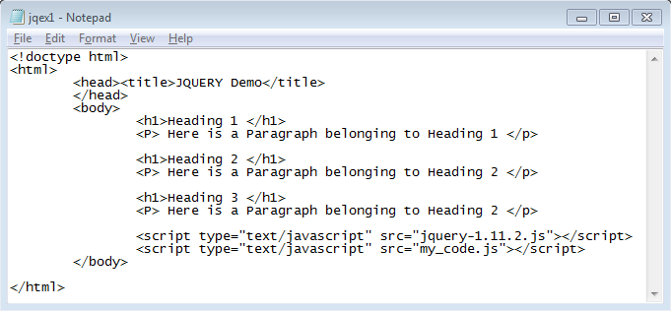
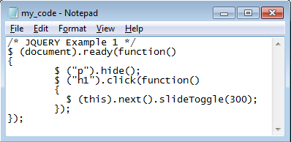
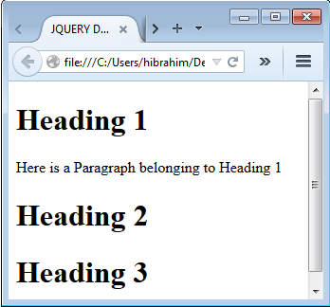
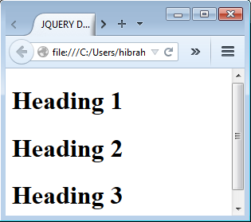
Example
$(document).ready(function(){
// jQuery methods go here...
});

Slide 8
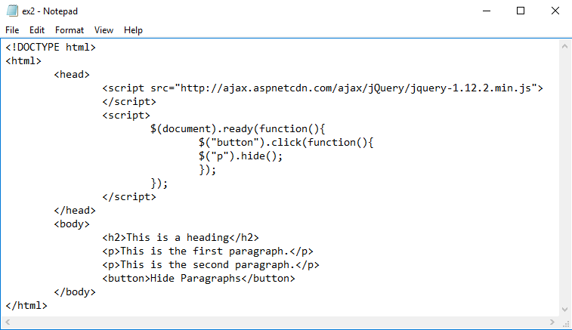
Adding jQuery to Web Pages
Compressed/Production/Minified Version
Ready Event: jQuery Code will be Executed
After Loading the Webpage
Minified Version: No whitespaces, No comments, hard to read

Slide 9
jQuery: Basic Syntax
$(selector).action()
$: Access jQuery
Selector: ID, Class, Tag Name → Finding HTML Elements
action(): Things Performed on Selected HTML Element(s)
Examples
$("p").hide() - hides all <p> elements.
$(".test").hide() - hides all elements with class="test".
$("#test").hide() - hides the element with id="test".
$(this).hide() - hides the current element.

Slide 10







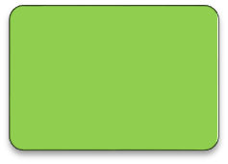
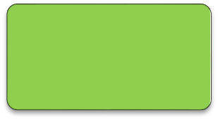
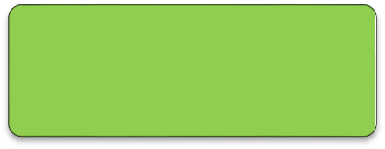
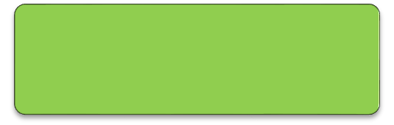
Basic Selectors
Tag Name: $("tagName") → $("div"), $("p"), $("div")
Tag ID: $("#id") → $("#name"), $("#address")
Tag Class: $(".className") → $(".comment"), $(".code")
Selecting All HTML Elements → $("*")
$("p")
<p>
$("div")
<div>
$("#foo")
id="foo"
$(".foo")
class="foo"

Slide 11
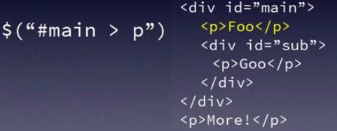
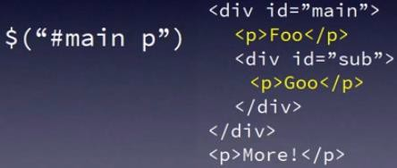
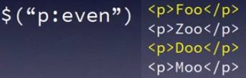
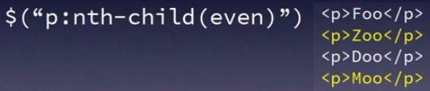
Combined Selectors
$("tagName.className") → $("h1.mainTitle")
$("tagName.className#tagId") →
$("h1.mainTitle#firstHeading")
selects all elements that are the nth child | nth-child(n|even|odd|formula)

Slide 12

Selecting/Manipulating HTML Elements
Selector Returns One or More HTML Elements
Each Element Corresponds to jQuery Object (Properties & Methods)
jQuery Object Has a Reference to The Selected Elements
$(‘li.hot’).hide();
hide(): jQuery Object Method
var $titles = $(‘.title’);
var $author = $(‘#author’); var $first = $(‘ul#list:first-child’);
When a variable holds a jQuery object, its name often begins with a $ symbol.

Slide 13



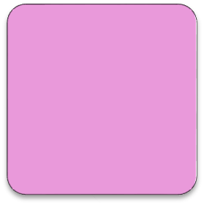
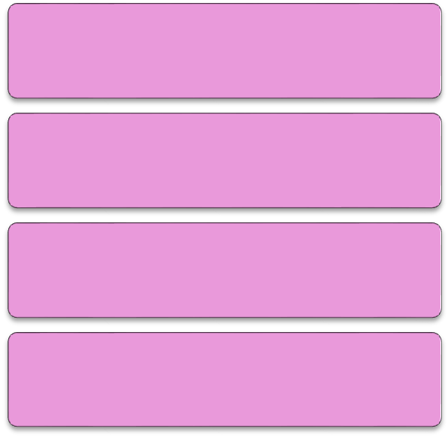
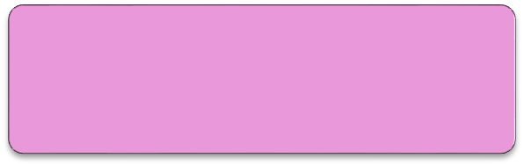
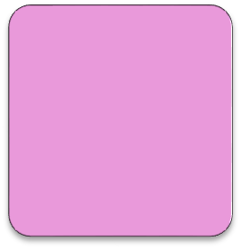
Break It Down
$(“p”).addClass(“isCool”);
$
("p")
.addClass("isCool");
Grabs a DOM element using a CSS selector.
Built in method that adds a class to the jQuery Collection
Initiates the jQuery function
Selector is in quotes.
Class is in quotes.
$
=
jQuery
Creates a jQuery “Collection”
<p>
ends with a semicolon.

Slide 14
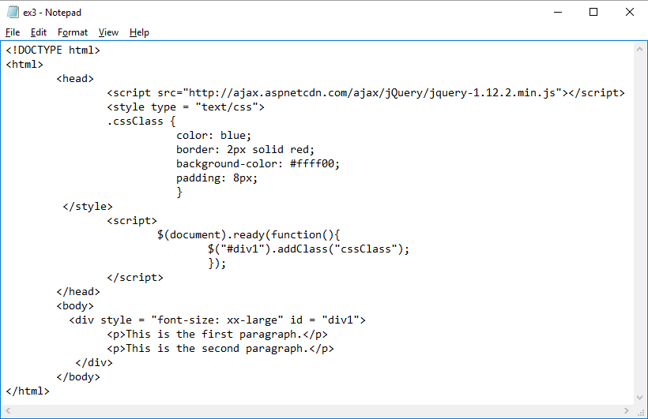

Example
addClass(): class = “cssClass”
Before: DIV has no Class
After: <div class = “cssClass”>

Slide 15
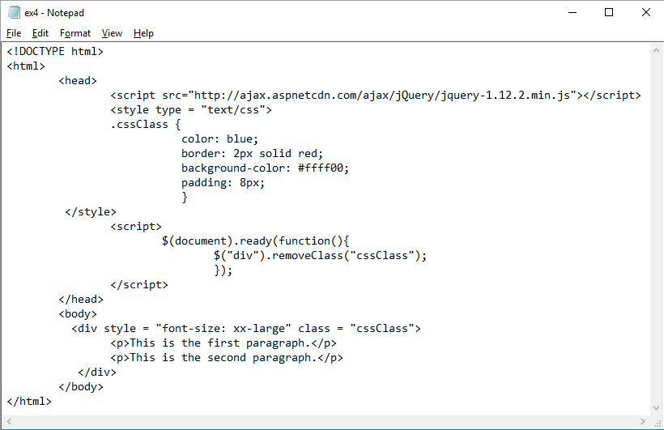
Example
removeClass()
Before: <div class = “cssClass”>
After: DIV has no Class

Slide 16


Example
<div style="display:none;">
<p id="eric">Is Lame</p>
$("div").show();
$("#eric").text("Is Cool");
<div style="display:block;">
<p id="eric">Is Cool</p>
Chaining Most Methods
$("p")
.addClass("sophisticated")
.text("Hello World!")
.show();

Slide 17
More Methods & Events
show() & hide() | Displaying or Hiding the selected Element
val() | Get/Set Value of Form Elements
parent() | returns the direct parent element of the selected element
text() | sets or returns the text content of the selected elements.
css() | Set a specified CSS property of the selected element
$("p").css("background-color", "yellow");
$("p").css({"background-color": "yellow", "font-size": "200%"});
$("#eric").click(function(){
$(this).text("Is Cool");
// this = #eric
alert(“jQuery is Cool!");
});
Click Event

Slide 18


Getters and Setters
Getter
Setter
$("#foo").text();
$("#foo").text("foo");
Dual Purpose Methods
Getter | Setter
<p>Eric</p> myVar = $("p").text(); | <p>Eric</p> myVar = “John”; $("p").text(myVar);
myVar = “Eric” | <p>John</p>
Thank You - Questions?

